Slide 1
This is CS50

Slide 2
Reminders
Masks are required. Please do not put classmates in a position of risk or discomfort by not adhering to protocol. And please do not put staff in a position of having to remind or escalate. Step outside or watch online instead.
No food or drink in Sanders, please!
If you'd like to view the projector screen on your own laptop during class and/or ask Carter questions via chat, visit cs50.ly/sanders, which will open a Zoom webinar. Be sure to mute your audio, as the webinar also contains video for those in isolation or quarantine.

Slide 3
This is CS50

Slide 4
internet

Slide 5
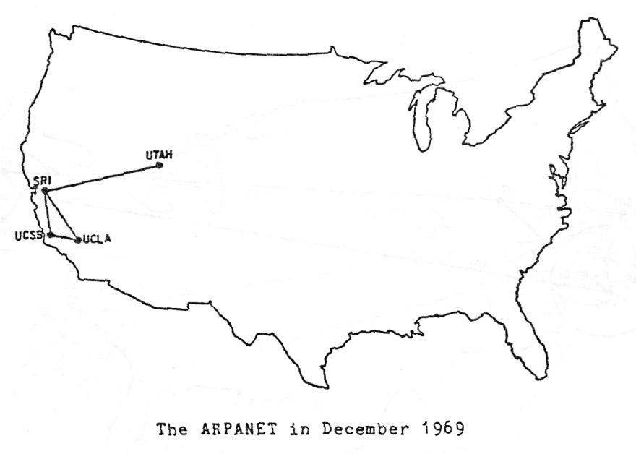
Notes:
http://mercury.lcs.mit.edu/~jnc/tech/arpageo.html

Slide 6
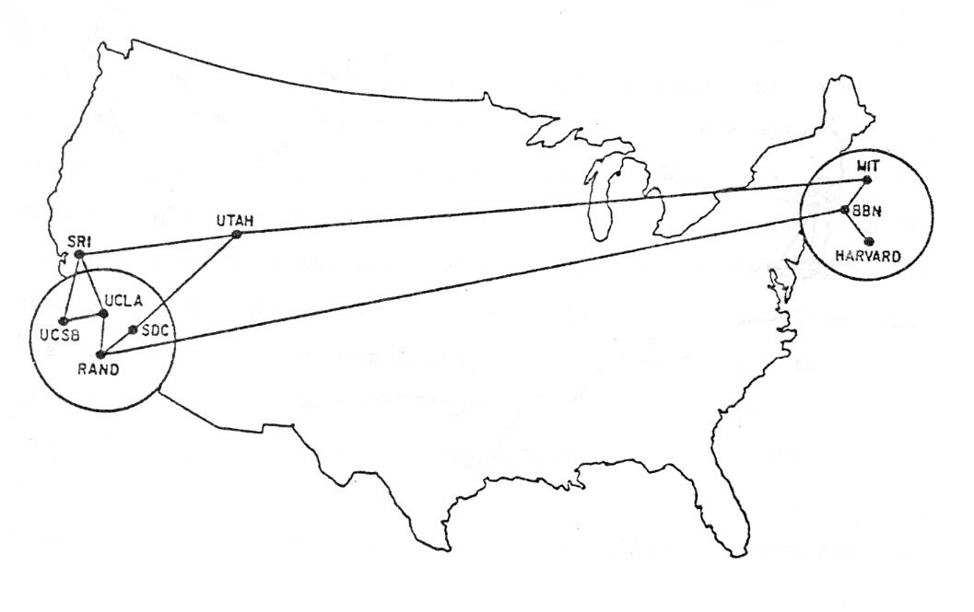
Notes:
http://mercury.lcs.mit.edu/~jnc/tech/arpageo.html

Slide 7
routers
Notes:
https://www.infrapedia.com/app

Slide 8
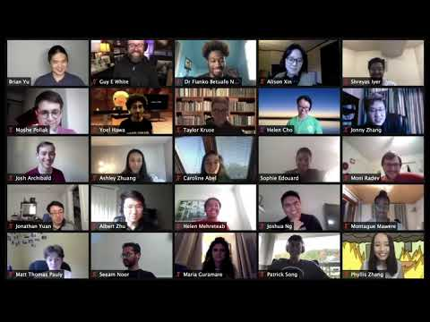
Notes:
envelope

Slide 9
TCP/IP

Slide 10
IP

Slide 11
#.#.#.#

Slide 12
TCP

Slide 13
80 HTTP
443 HTTPS
...

Slide 14
DNS
Notes:
safetyschool.org
harvardsucks.org
yalesucks.com

Slide 15
Fully Qualified Domain Name | IP Address

Slide 16
Fully Qualified Domain Name | IP Address

Slide 17
HTTP

Slide 18
HTTPS

Slide 19
https://www.example.com

Slide 20
https://www.example.com/

Slide 21
https://www.example.com/path

Slide 22
https://www.example.com/file.html

Slide 23
https://www.example.com/folder/

Slide 24
https://www.example.com/folder/file.html

Slide 25
https://www.example.com/folder/file.html

Slide 26
https://www.example.com/folder/file.html

Slide 27
https://www.example.com/folder/file.html

Slide 28
https://www.example.com/folder/file.html

Slide 29
https://www.example.com/folder/file.html

Slide 30
GET
POST
...
Notes:
diagram

Slide 31
GET / HTTP/1.1
Host: www.example.com
...

Slide 32
HTTP/1.1 200 OK
Content-Type: text/html
...

Slide 33
GET / HTTP/1.1
Host: www.harvard.edu
...
Notes:
curl -I -X GET http://harvard.edu/

Slide 34
HTTP/1.1 301 Moved Permanently
Location: https://www.harvard.edu/
…

Slide 35
HTTP/1.1 404 Not Found
Content-Type: text/html
...

Slide 36
200 OK 301 Moved Permanently 302 Found 304 Not Modified 307 Temporary Redirect 401 Unauthorized 403 Forbidden 404 Not Found 418 I'm a Teapot 500 Internal Server Error 503 Service Unavailable ...

Slide 37
GET / HTTP/1.1
Host: safetyschool.org
...
Notes:
curl -I -X GET http://safetyschool.org/

Slide 38
GET / HTTP/1.1
Host: www.harvardsucks.org
...
Notes:
curl -I -X GET http://www.harvardsucks.org/

Slide 39
GET / HTTP/1.1
Host: www.yalesucks.com
...
Notes:
curl -I -X GET http://www.yalesucks.com/

Slide 40
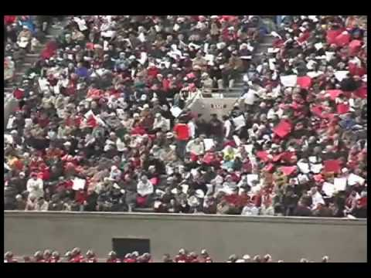

Slide 41
HTML

Slide 42
tags
attributes

Slide 43
<!DOCTYPE html>
<html lang="en">
<head>
<title>
hello, title
</title>
</head>
<body>
hello, body
</body>
</html>
Notes:
hello0.html

Slide 44
http-server

Slide 45
<!DOCTYPE html>
<html lang="en">
<head>
<title>
hello, title
</title>
</head>
<body>
hello, body
</body>
</html>

Slide 46
<!DOCTYPE html>
<html lang="en">
<head>
<title>
hello, title
</title>
</head>
<body>
hello, body
</body>
</html>

Slide 47
<!DOCTYPE html>
<html lang="en">
<head>
<title>
hello, title
</title>
</head>
<body>
hello, body
</body>
</html>

Slide 48
<!DOCTYPE html>
<html lang="en">
<head>
<title>
hello, title
</title>
</head>
<body>
hello, body
</body>
</html>

Slide 49
<!DOCTYPE html>
<html lang="en">
<head>
<title>
hello, title
</title>
</head>
<body>
hello, body
</body>
</html>

Slide 50
<!DOCTYPE html>
<html lang="en">
<head>
<title>
hello, title
</title>
</head>
<body>
hello, body
</body>
</html>

Slide 51
<!DOCTYPE html>
<html lang="en">
<head>
<title>
hello, title
</title>
</head>
<body>
hello, body
</body>
</html>

Slide 52
<!DOCTYPE html>
<html lang="en">
<head>
<title>
hello, title
</title>
</head>
<body>
hello, body
</body>
</html>

Slide 53
<!DOCTYPE html>
<html lang="en">
<head>
<title>
hello, title
</title>
</head>
<body>
hello, body
</body>
</html>

Slide 54
<!DOCTYPE html>
<html lang="en">
<head>
<title>
hello, title
</title>
</head>
<body>
hello, body
</body>
</html>

Slide 55
<!DOCTYPE html>
<html lang="en">
<head>
<title>
hello, title
</title>
</head>
<body>
hello, body
</body>
</html>

Slide 56
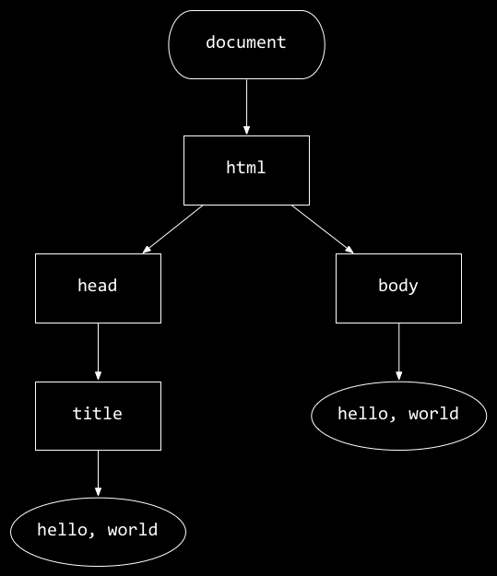
<!DOCTYPE html>
<html lang="en">
<head>
<title>
hello, title
</title>
</head>
<body>
hello, body
</body>
</html>
hello, body
hello, title

Slide 57
https://www.example.com/path

Slide 58
https://www.example.com/path?key=value

Slide 59
GET /search?q=cats HTTP/1.1
Host: www.google.com
...

Slide 60
validator.w3.org

Slide 61
CSS

Slide 62
properties

Slide 63
type selector
class selector
ID selector
attribute selector
...
Notes:
https://developer.mozilla.org/en-US/docs/Web/CSS/CSS_Selectors

Slide 64
<!DOCTYPE html>
<html lang="en">
<head>
<title>
hello, title
</title>
</head>
<body>
hello, body
</body>
</html>

Slide 65
<!DOCTYPE html>
<html lang="en">
<head>
<style>
</style>
<title>
hello, title
</title>
</head>
<body>
hello, body
</body>
</html>

Slide 66
<!DOCTYPE html>
<html lang="en">
<head>
<link href="styles.css" rel="stylesheet">
<title>
hello, title
</title>
</head>
<body>
hello, body
</body>
</html>

Slide 67
frameworks
Notes:
https://getbootstrap.com/

Slide 68
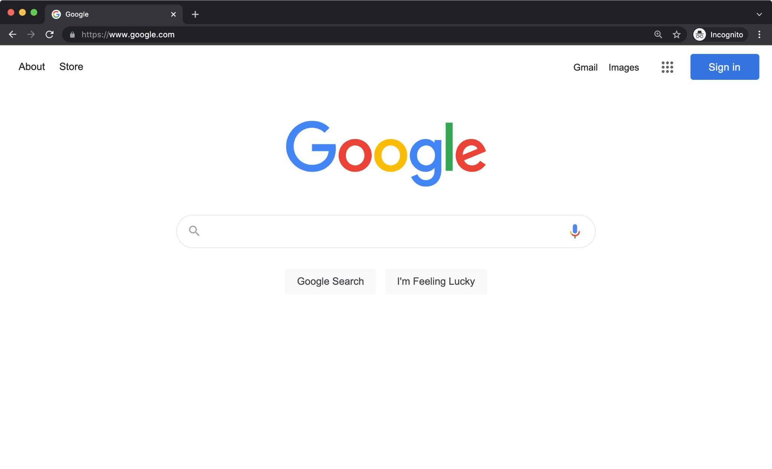
Notes:
https://icons.getbootstrap.com/

Slide 69
JavaScript

Slide 70
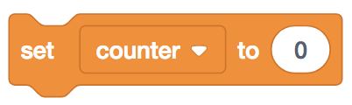
let counter = 0;

Slide 71
let counter = 0;

Slide 72

counter = counter + 1;

Slide 73
counter = counter + 1;

Slide 74
counter += 1;

Slide 75
counter++;

Slide 76
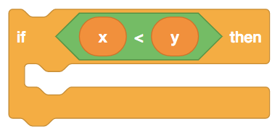
if (x < y) {
}

Slide 77
if (x < y) {
}

Slide 78
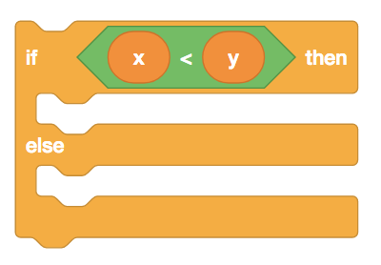
if (x < y) {
}
else
{
}

Slide 79
if (x < y) {
}
else
{
}

Slide 80
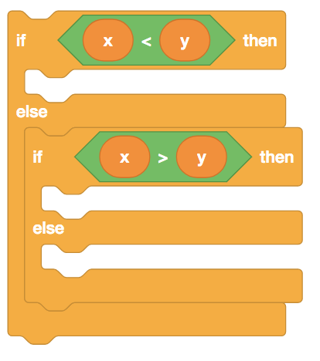
if (x < y) {
}
else if (x > y)
{
}
else
{
}

Slide 81
if (x < y) {
}
else if (x > y)
{
}
else
{
}

Slide 82
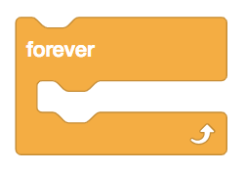
while (true)
{
}

Slide 83
while (true)
{
}

Slide 84
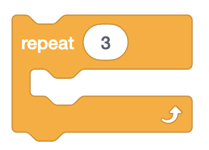
for (let i = 0; i < 3; i++)
{
}

Slide 85
<!DOCTYPE html>
<html lang="en">
<head>
<title>
hello, title
</title>
</head>
<body>
hello, body
</body>
</html>
hello, body
hello, title

Slide 86
<!DOCTYPE html>
<html lang="en">
<head>
<title>
hello, title
</title>
</head>
<body>
hello, body
</body>
</html>

Slide 87
<!DOCTYPE html>
<html lang="en">
<head>
<script>
</script>
<title>
hello, title
</title>
</head>
<body>
hello, body
</body>
</html>

Slide 88
<!DOCTYPE html>
<html lang="en">
<head>
<script src="scripts.js"></script>
<title>
hello, title
</title>
</head>
<body>
hello, body
</body>
</html>

Slide 89
<!DOCTYPE html>
<html lang="en">
<head>
<title>
hello, title
</title>
</head>
<body>
hello, body
<script>
</script>
</body>
</html>

Slide 90
<!DOCTYPE html>
<html lang="en">
<head>
<title>
hello, title
</title>
</head>
<body>
hello, body
<script src="scripts.js"></script>
</body>
</html>

Slide 91
blur change click drag focus keyup load mousedown mouseover mouseup submit touchmove unload ...

Slide 92
callbacks

Slide 93
This is CS50

